Slide 1
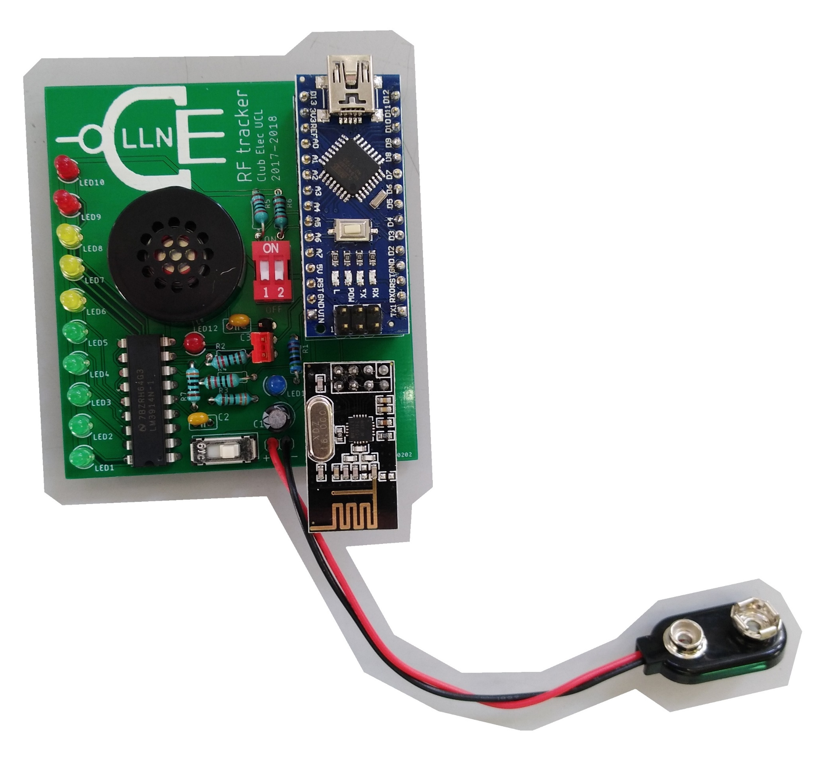
Buzzer
Module
Arduino
LEDs
&
driver
Module
nrf24
Alimentation 9V

